Slide 1

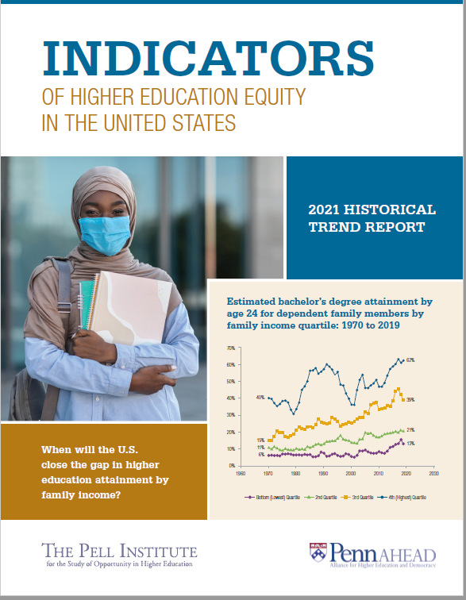
Seventh Annual Release Event
Indicators of Higher Education Equity in the United States
2021 Historical Trend Report
&
Search for Solutions Shared Dialogues
Reconstruction for Equity with a focus on Nontraditional Independent Students
May 19, 2021

Slide 2
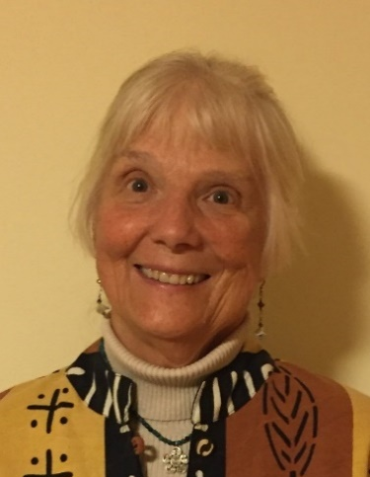
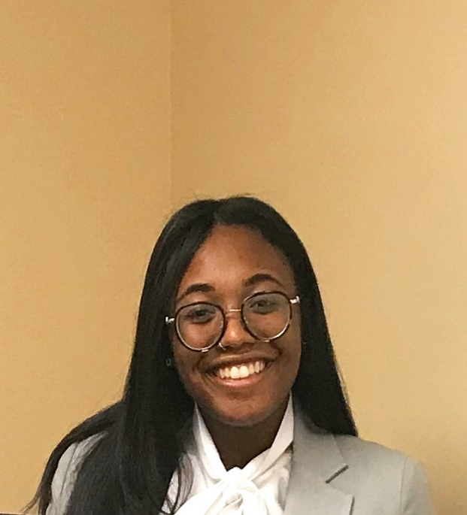
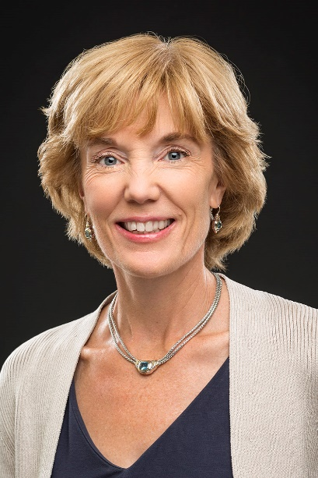


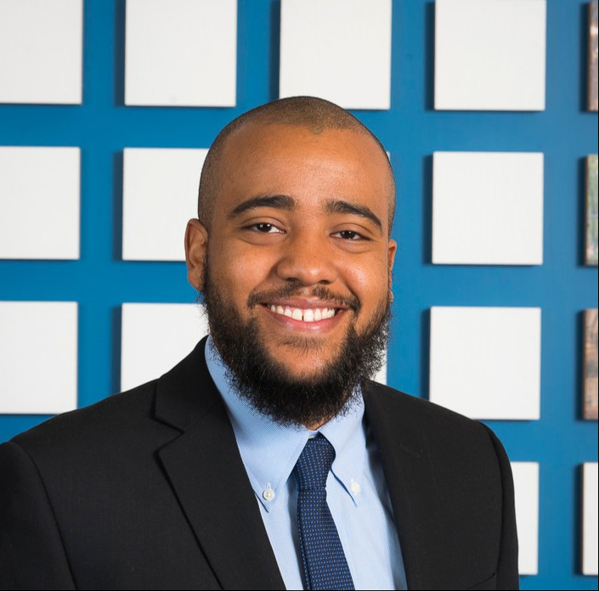

Warm Welcome to all From 2021 Indicators Project Team Co-Hosts!
Margaret Cahalan, Marisha Addison, Nicole Brunt, Terry Vaughan III, Alysia Genoa,
Pell Institute for Study of Opportunity in Higher Education, Council for Opportunity in Education (COE)
Laura Perna and Pooja Patel
Alliance for Higher Education and Democracy
University of Pennsylvania (PennAHEAD)

Slide 3



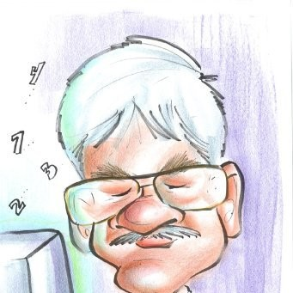


  Government, contractor, and academic research teams
  Backbone support from COE & Penn
  Special thanks to COE board
SPECIAL THANKS FOR SUPPORT FROM:

Slide 4
Post-Pandemic Reconstruction for a Non-Zero-Sum Game U.S. Higher Education System: A New Equity Paradigm with a focus on
Nontraditional Independent Students
Agenda for the Afternoon
Welcome, Overview of Statistics
Researcher, Practitioner, and Student Voices
Break Outs for Shared Solutions Dialogues
Report Out & Wrap-Up Reflections

Slide 5

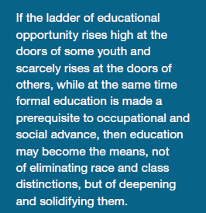
Background: Project began in 2015 to Address the Concerns Expressed as Early as 1947 Truman Commission Presidential Report
Goals of Equity Indicators Project
Annual Report and Track Our Progress
Hold Stakeholders’ Shared Solutions Dialogues
Support Equity Actions

Slide 6
Major Issues of Shared Solutions Dialogues for 2021
Inequity of Institutional Resources. Most low-income and non-traditional students are in less-resourced institutions? What are the policies and practices that need to be changed to have more equalization of institutional resources?
Growing Unmet Financial Need and Debt. The debt burden is growing and falls most heavily on nontraditional students, low-income students, and students of color. What are the policies and practices that need to be changed to address unmet needs and student debt burden?
Complexity and Intersectionality of Supports Needed for Successful Completion. What policies and wider supports are needed to address the complex needs of low-income, first-generation and nontraditional students to help them complete their programs and meet their career goals?

Slide 7
What Do We Mean by a Reconstruction for Equity Paradigm Shift?
A Grandmother’s Vision for New Mature Higher Education (HE) Ecosystem
New Equity Higher Education Eco-System
Current Higher Education Commodity System
HE as human right
Co-operation and co-learning drives excellence-
Intentional Equalization of institutional resources is necessary for Healthy System and social justice.
Diversity and Complexity leads to Resilience Whole is stronger because of very differential contributions (corn beans and squash)
Dynamic co-evolving-Empathetic Problem Solving for public good drives agenda
HE as Investment consumer commodity—human capital
Competition for achievement and rank drives excellence
Intentional cost differentiation broadens access
“Merit” Based Monoculture Grouping promotes excellence
Maintenance of Our System –We have proven patterns: and those that can pay and fund drive agenda.

Slide 8
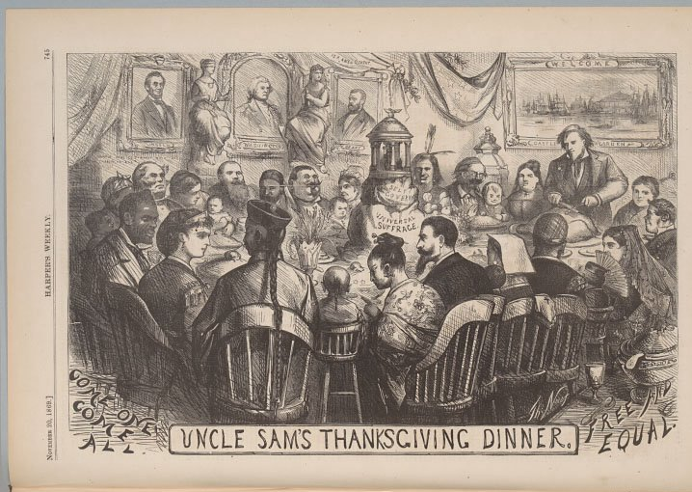


Post-COVID Reconstruction for a New Equity Paradigm
From a Hierarchical System Highly Segregated by SES and Race/Ethnicity to a Round Thanksgiving Table—Reconstruction Era Harpers Weekly 1869
Key Question: How to Co-Evolve to a Diverse Complex Non-Zero-Sum Game Higher Education System of Mutual Benefit that Works for All??

Slide 9
Indicators Reports Organized Around 7 sets of Questions
Setting the Stage
Indicator 1: Who enrolls in postsecondary education?
Indicator 2: What type of institution do students attend?
Indicator 3: Does financial aid and cost differences eliminate financial barriers?
Indicator 4: How do students pay for college?
Indicator 5: Does bachelor’s degree attainment vary by family characteristics?
Indicator 6: How do attainment rates in U.S. compare with other nations?
New Indicator 7: The Federal TRIO Programs: Who, What, Where, When, Why, and How Does TRIO Work?

Slide 10
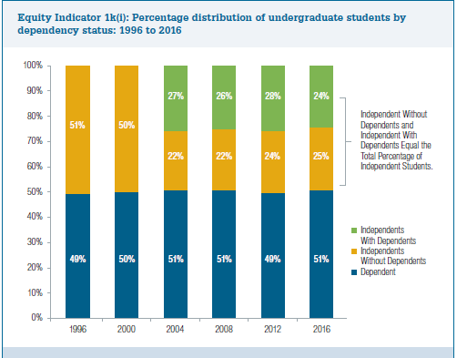
What Do We Mean by Independent Students and What Proportion of Students are Independent?
Dependency status is largely defined by age. Unless married or other specific circumstances, all students under age 24 are classified as dependent whether or not their parents are supporting them financially, and those 24 or over are independent.
Consistently NPSAS finds that about half of all full and part time undergraduate enrollment is classified for financial aid purposes as independent.
About 40 to 50 percent of students classified as Independent students have dependents.

Slide 11
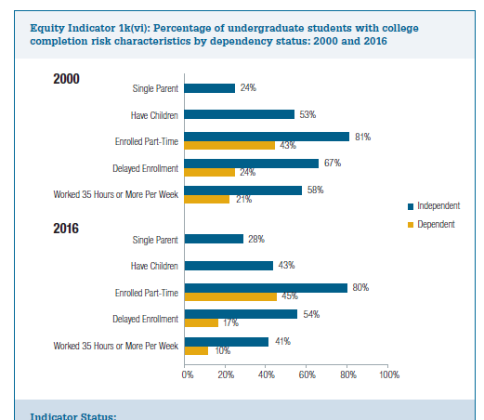
Independent Students Face -Many Risk Factors to Completion
2016 data
80 percent are enrolled part-time
43 percent have dependent children and 28 percent are single parents
40 percent work full time
54 percent have delayed enrollment (Indicators 1k(i) and 1k(vi)).

Slide 12
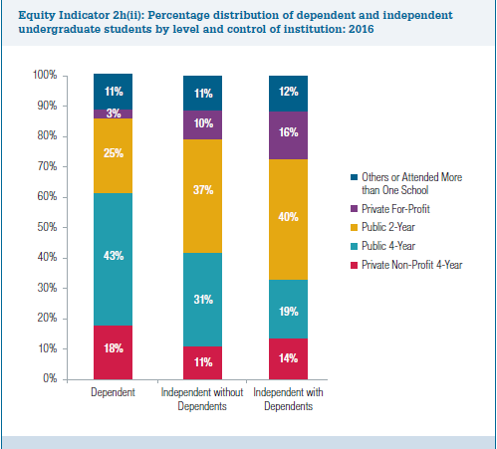
Most Independent Students Are Enrolled in Less Resourced Institutions with Low Spending per FTE Student.
Over 80 percent of independent students with dependents and over 70 percent of independent students without dependents were in Broad Access (open or non-selective) 2-year or 4-year institutions (Indicator 2h(ii) with low spending per FTE

Slide 13
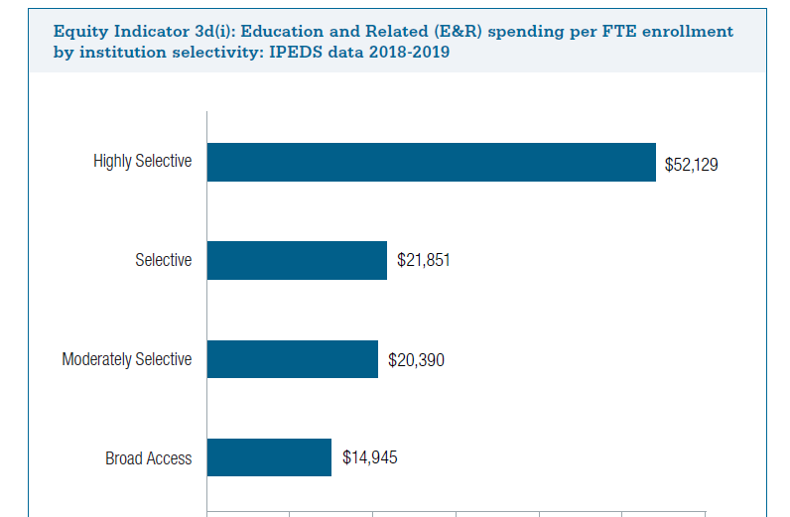
Inequity of Institutional Resources: Average Education and Related (E&R)Spending per FTE enrolled student ranges from $52,129 for Highly Selective Institutions to $14,945 for Broad Access Institutions (Hillman 2020)

Slide 14
Socioeconomic Status (SES) & Selectivity
Chance of going to Most or Highly Competitive college is 8 Times higher for highest quintile than lowest quintile
  33 % highest SES Quintile
  4 % lowest SES Quintile

Slide 15
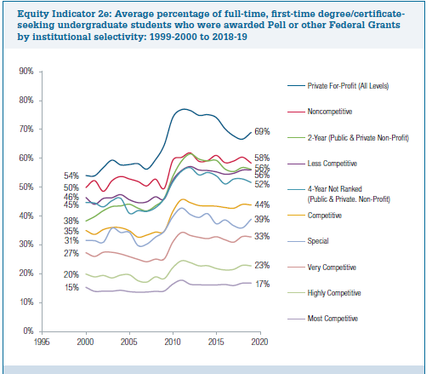
As Selectivity Increases –Percent Pell Decreases
Notes:
Nicole

Slide 16
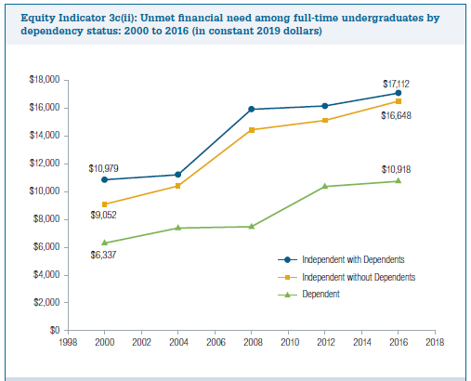
Average Levels of Unmet Need (after all Grants) for Independent Students are Almost Twice Those of Dependent Students
Independent students with dependents averaged $17,112 per year
Independent students without dependents averaged $16,658.
Dependent students ($9,052)
(Indicator 3cii).

Slide 17
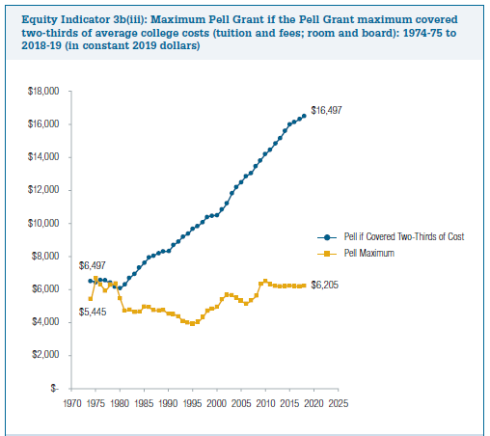
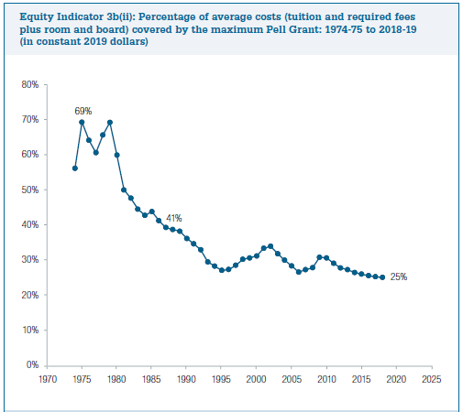
In 2019 Pell Maximum Covered 25 % of Costs

Slide 18
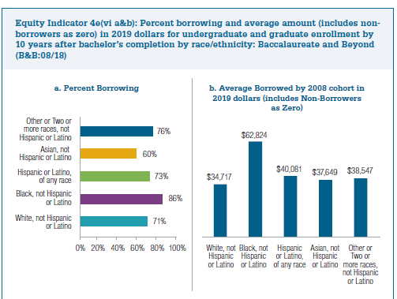
Race/Ethnicity Debt Gaps Grow 10 Years After Award of Bachelor’s

Slide 19


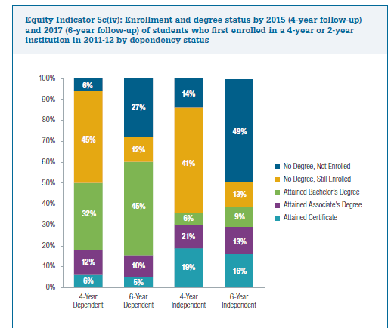


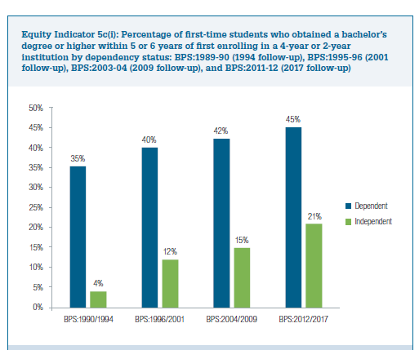

Barriers are Very High to Completion for Independent Students
Most Recent BPS 6-year follow-up
38 percent had obtained a degree or certificate and 13 percent were still enrolled after 6 years
49 percent were not enrolled and had obtained no degree
Considering only 2- or 4-year degree seekers 21 percent had obtained a bachelor’s degree after 6 years compared with 45 percent of dependent students
(Indicator 5c(iv) and 5c(i)).

Slide 20
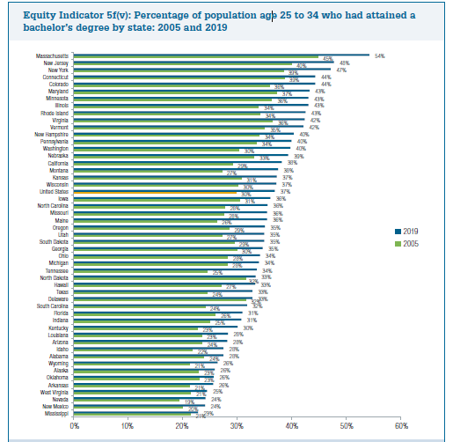
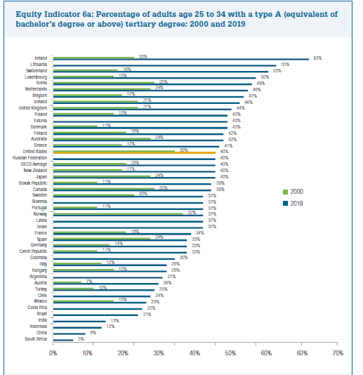
U.S. States Vary Almost as Much as OECD Countries

Slide 21
Website
http://pellinstitute.org/indicators/
Reports Link to 2021 Indicators Report
Provides excel data for each of the charts
Posting of presentations and Shared Dialogue Forms
Coming Soon—Interactive Dynamic Charts
Link to Personal Input on-line Survey https://fs12.formsite.com/DZNAsc/unbezm2a1x/index.html
See the hash tag #EquityIndicators2021 on social media. Background Briefs are posted on the web cast site:

Slide 22
Laura W. Perna, University of Pennsylvania
Vice Provost for Faculty
Centennial Presidential Professor of Education

Slide 23
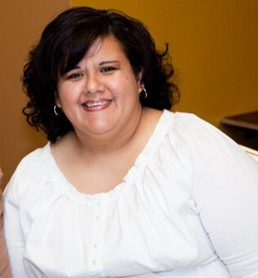
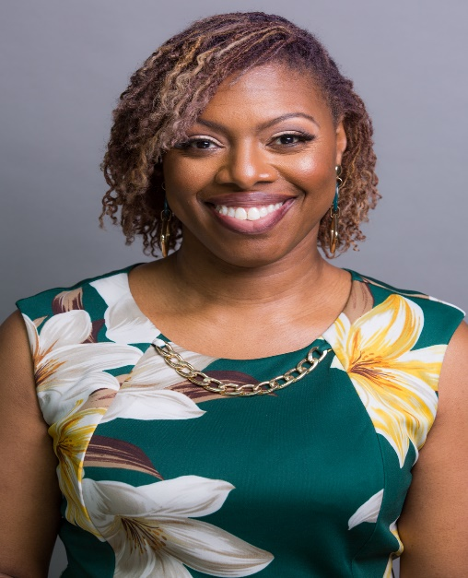
2021 Indicators of Higher Education Equity:
Panel on Non-Traditional Students:
Scholars and Practitioners
Marielisbet Lisa Perez
University of Illinois at Urbana-Champaign
Nayshon Mosley
Chicago State University

Slide 24

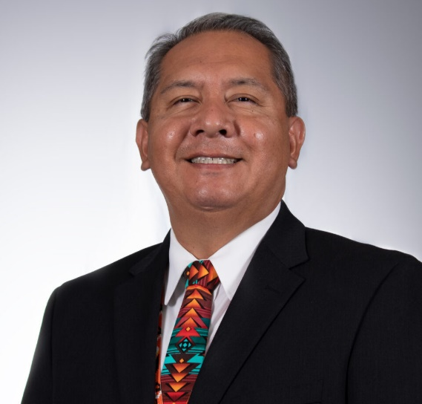
2021 Indicators of Higher Education Equity:
Panel on Non-Traditional Students’
Student Voices
Virgil Rambeau, Sacramento, California
Native American Health Center (SNAHC)
Essence Onanuga, Chicago, Illinois
DePaul University

Slide 25

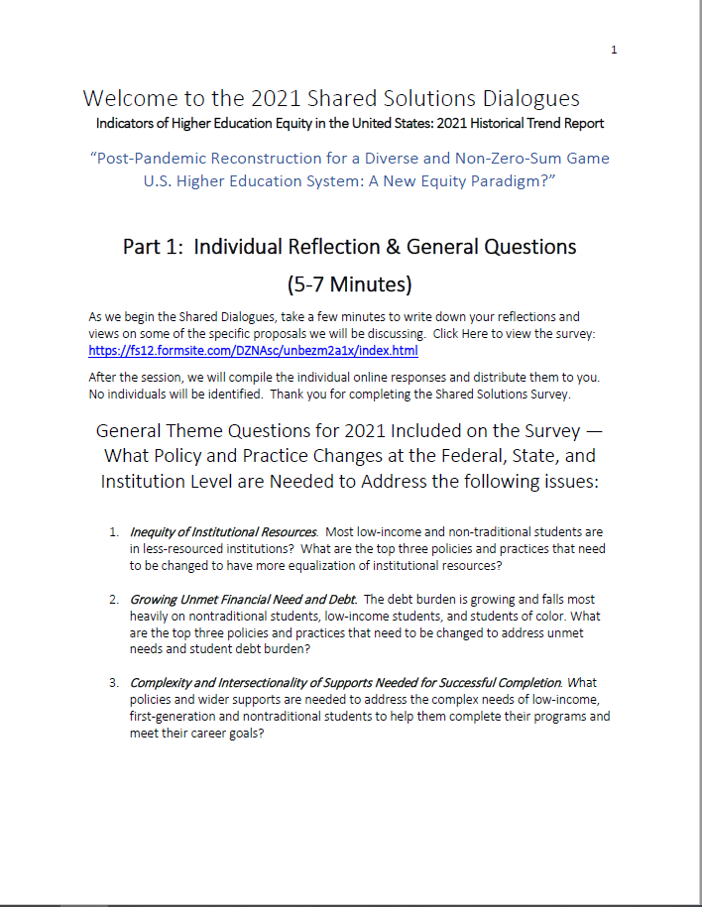
2021 Indicators Report:
Shared Dialogues

Slide 26

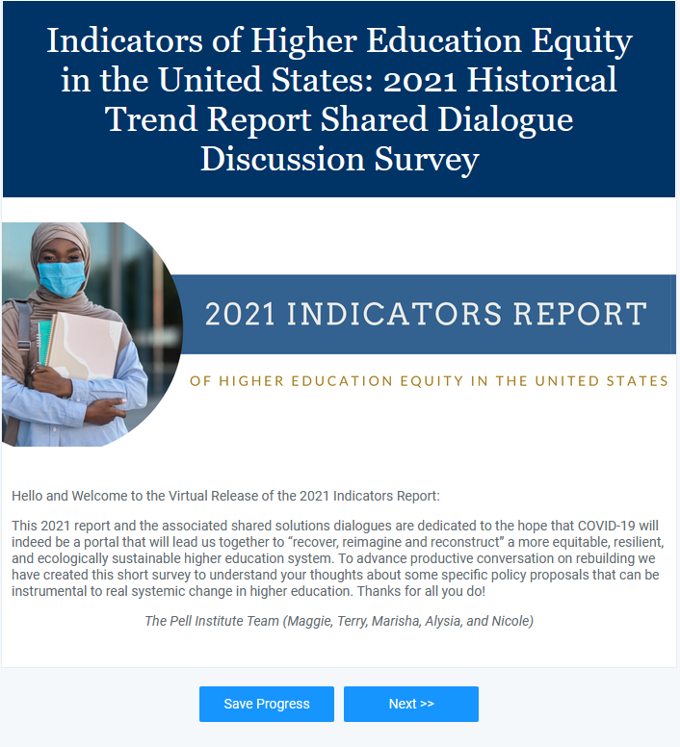
2021 Indicators Report:
Take the Survey

Slide 27

2021 Indicators Report:
Closing Thoughts

